Slide 1

Why Did Google and Facebook Miss The Boat on Healthcare?

Slide 2
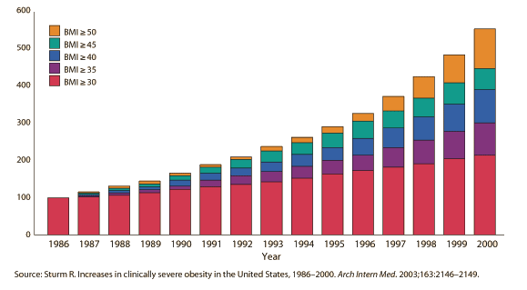









Market Opportunity
Obesity Rate Soaring
US BMI by Year
Consumer Health Engagement Growth
1
2
Health plans spend $11 billion year on transient consumer engagement efforts
Market for wearable wireless devices in sports and healthcare will grow to 169.5 million devices in 2017, up from 20.77 million in 2011, a CAGR of 41%.
$2T Health and Wellness Market
Estimated global market size of the wellness industry
No Entity has complete solution
Health and Wellness Market is scattered
3
Tuesday, October 16, 2012
GoodChime (C) 2011
2
Notes:
How bad is the problem?
Between 1986 and 2000, the prevalence of people with a BMI above 40% quadrupled from about 1 in 200 adult Americans to 1 in 50,
Investments in consumer health engagement have similarly grown
Several organizations have invested in addressing these concerns but failed to address the whole picture (get their interest, offer realistic programs for change, keep them engaged and make money)
The health and wellness market continues to surge, estimated to be $2 trillion dollars by 2012
2

Slide 3
Captive Audience Based On Volume
“1 In 5 Use Facebook To Make Health Decisions” Source: www.allfacebook.com, March 2011
“More people using Facebook for health info before face time with a physician”
Source: National Resource Corporation, May 2011
“41% use social media sites to look for health information. Of those, nearly 94% said Facebook was their site of choice.”
Source: National Resource Corporation, May 2011

Slide 4


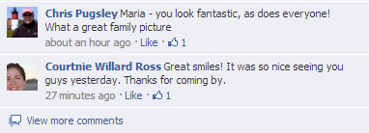

Facebook As a Destination
1 In 5 Use Facebook To Make Health Decisions*
HOW PEOPLE USE TO SELF DIAGNOSIS AND MAKE PURCHASES
WALL POST
“Joey is sick, anyone else catch the flu?”
FRIEND RECC
“I bought a Nettie pot for Suzy”
TRANSACT
Who has best deal and where
* www.allfacebook.com, March 11, 2011

Slide 5


Who Cares About Privacy?
Privacy is becoming less and less of an issue
Age
Gender
Treatment
Symptom
Condition
Interests
Check-in
Friends
Application preferences
Event photos
Real time location
Search

Slide 6





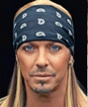

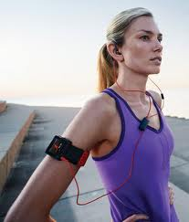
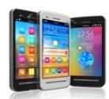
Dictionary Of Social Trends
Capturing Demographic, Purchasing Trends and Health Habits
Morning
Lunch
Afternoon
Dinner time
Completes
Challenge
Make Appointment
Check Rank
Celebrity gossip
New Signup
Sleep App
Dinner Recipe
Lunch Recipe
Log Health
with device
Logs Challenge
More gossip

Slide 7

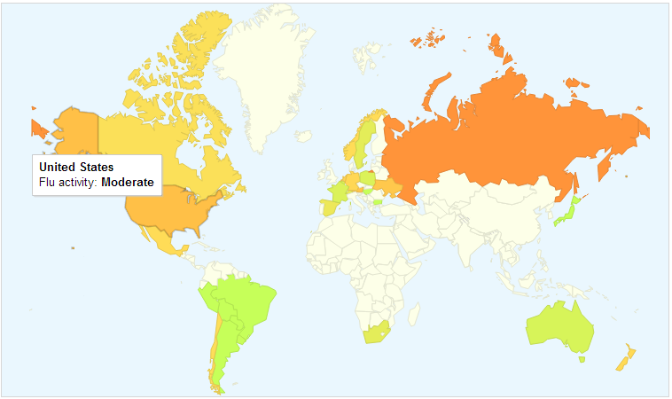

Serach As A Proxy for Trends
Flu Activity by Country
Search Trends
Each week, millions of users around the world search for health information online. There are more flu-related searches during flu season, more allergy-related searches during allergy season, and more sunburn-related searches during the summer.

Slide 8

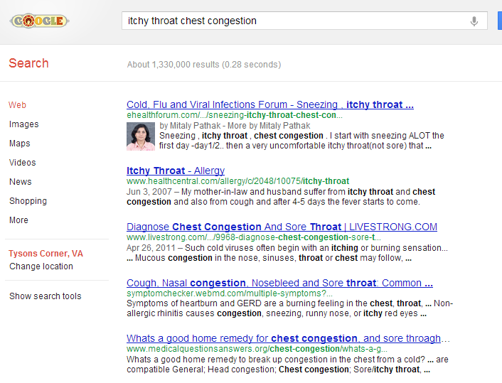
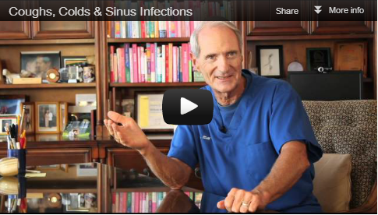

The Reactive Consumer
HOW PEOPLE USE TO SELF DIAGNOSIS AND MAKE PURCHASES
SYMPTOM
“itchy throat chest congestion”
LEARN
Four major cold medications
TRANSACT
Who has best deal and where

Slide 9

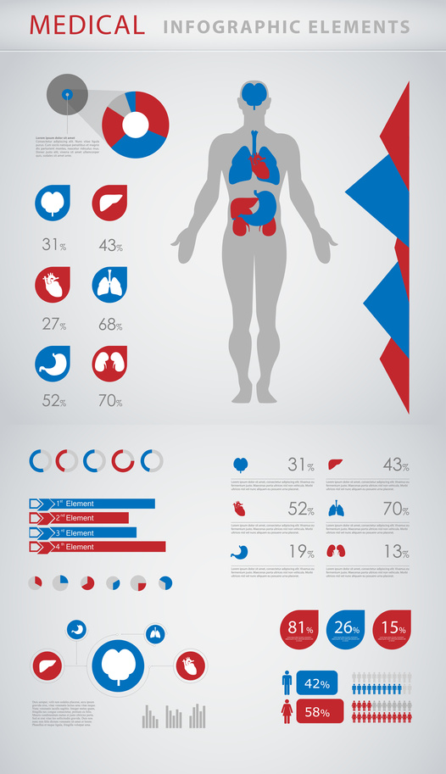


Platform or Application…Google Health??
Google Health was a personal health information centralization service by Google introduced in 2008 and announced for withdrawal in 2011. The service allowed Google users to volunteer their health records – either manually or by logging into their accounts at partnered health services providers – into the Google Health system, thereby merging potentially separate health records into one centralized Google Health profile.
One location for you and your family’s records | Monitor chronic conditions and share health data with your physician | Track progress and stay healthy

Slide 10

















Health and Wellness Market
Personal Health Records
Applications and devices
Content Providers
Retailers
Tuesday, October 16, 2012
GoodChime (C) 2011
10
Notes:
Health and wellness market is extremely fragmented, "There are thousands of companies that have applications in the IT Health and Wellness space. Good Chime is unique in that it acts as the platform that can incorporate all of these disparate, targeted applications into a unified format that can engage and motivate consumers of all ages. Good Chime is poised to be the catalyst that alters the dysfunctional fee for service medical system we are all trying to change".
10

Slide 11
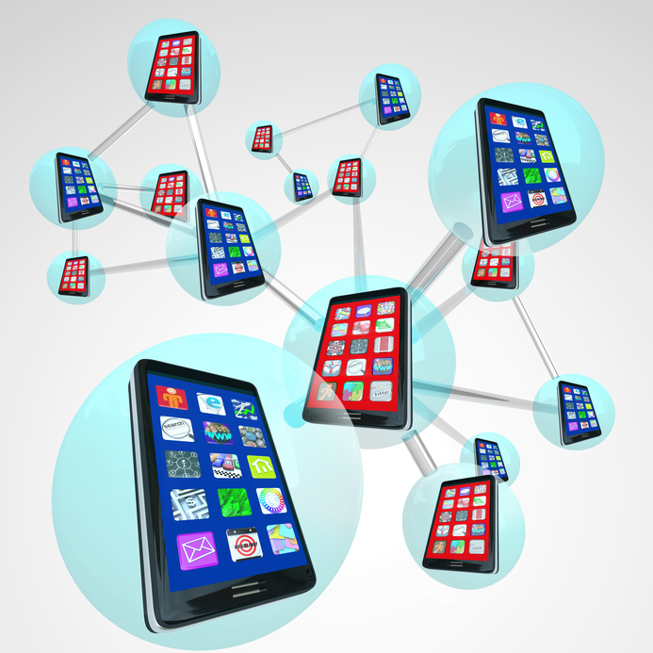



Planes and Phones,
Technology enables us to use a single device to access everything
Health Profile
Location Aware
Social Sharing
Fitness Recording
Credit Card
Photos
Email
THE MOST ENGAGING
PLATFORMS
WILL BE:
Agnostic – syncs with top devices and apps
Entertaining –videos to motivate engagement
Addictive – easy to use and engaging

Slide 12
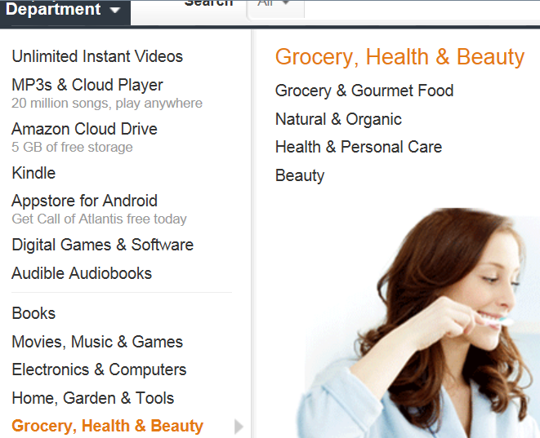
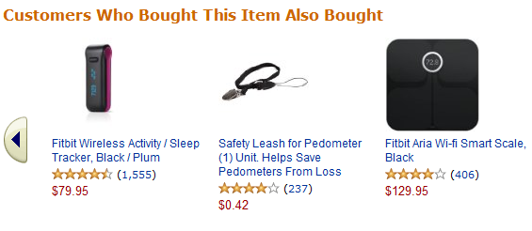
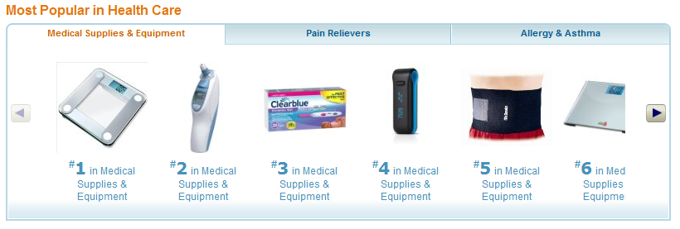
The Amazon Experience
NUTRITION & EXERCISE FOCUSED NAV
CONDITION TARGETED
PRODUCT SHOWCASES
CROSS CATEGORY PRODUCT RECC’S

Slide 13
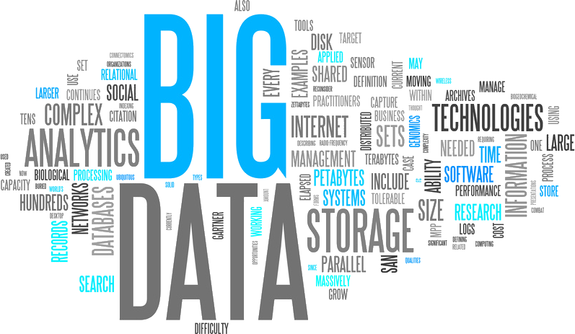
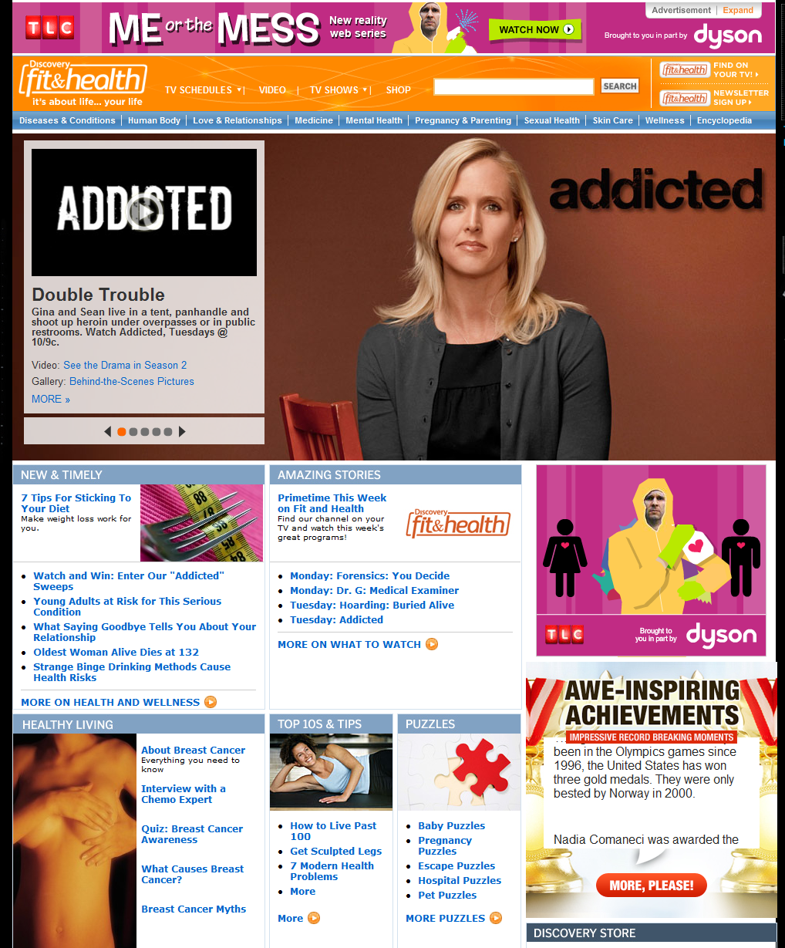




Data Ignites Revenue
PRECISE
TARGETED
OFFERS
via retargeted banners
Ad Banners
Mobile Apps
Social Media

Slide 14





Timing is Everything
Free ticket to special Bikram Yoga tonight
Blueberries are 40% off for my smoothie
All remaining size 10.5s are 75% off

Slide 15

Does Community Work for Health
The amount and type of information people are willing to share has grown, compared to what they find most personal

Slide 16
Data is Plural ..Not Singular
Age
Race
Gender
Location
Celebrity/Charity
Social Media Keywords
Device Data
Condition Forecast
health logs
challenge results
third party data such as location, weather, traffic data with health data for personalization
History of places last visited
Buying Behavior and History
opened
distributed
purchased
reviewed
repurchased
Based on one member’s profile and buying behavior, product/service/content recommendations can be made to different members with similar profiles.
Age
Race
Gender
Location
Celebrity/Charity
Social Media Keywords
Device Data
Condition Forecast
health logs
challenge results
third party data such as location, weather, traffic data with health data for personalization
History of places last visited
Buying Behavior and History
opened
distributed
purchased
reviewed
repurchased
Recommendations can include a variety of items including but not limited to…
PRODUCTS
recommendations based on matching profiles as illustrated above
CONTENT
recommendations based on existing inventory of content( print,video.digital) of third parties
APPLICATION
recommendations for monitoring of personal health and fitness

Slide 17




HEALTHCARE COMSUMER IN 2020
I sign up for Matthew’s campaign on Good Chime! from his Facebook page and become a member of Good Chime!
I follow Matthew’s challenge and run 1 mile a day five times a week.
I track my progress and how far I have run through my Nike Fuelband and that information automatically uploads to my Good Chime! account.
My running shoes seem a little old and I just got an alert for a discount at Sports Authority for a new pair of Nike running shoes that is $20 off.
I am a 30 year old white female from California who is a fan of Matthew McConaughey and just found out from his Facebook page that he has launched a campaign to encourage people to focus on fitness and weight loss.

Slide 18



HEALTHCARE COMSUMER IN 2020
I sign up for Matthew’s campaign on Good Chime! from his Facebook page and become a member of Good Chime!
I follow Gary’s nutrition challenge and replace my breakfast with his smoothies.
I track my progress using one of GoodChime’s nutrition partner apps
Over the last month, I have earned about 2,500 points on Good Chime!
and now I get access to even better discounts at Walgreens, Sports
Authority and Safeway for the things that keep me healthy.
I am a 52 year old male from Michigan who is a fan of Gary Player. My place of work has a wellness program that if I can show them how much I am working out, I receive a $100 credit on my savings account for every exercise.

Slide 19



HEALTHCARE COMSUMER IN 2020
I sign up for Ray Lewis’ campaign on Good Chime! from his Facebook page and become a member of Good Chime!
I follow Ray’s nutrition challenge and follow his four week meal plans.
I track my progress using one of GoodChime’s nutrition partner apps
GoodChime has learned where I shop and sends me offers based on my location, the store’s inventory and new products.
I am a 45 year old female from Atlanta who is a fan of Ray Lewis. I pride myself on providing a nutritious rich diet for me and my family. I am interested in learning about the latest nutrition trends from both friends and experts

Slide 20





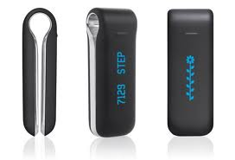
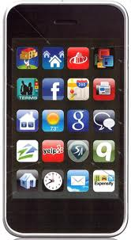


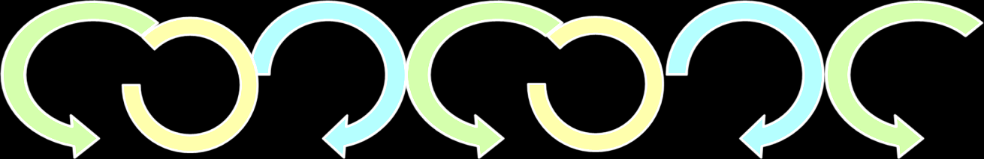
Platform
Engagement
Dashboard
Mobile
Video & Content
Games
Transaction
Predictive Analytics
Collaborative Platform with APIs
Physician Communication | Devices | Applications | Retail Inventory | Third Party Content
Ecosystem
Notes:
A unique health challenge that is simple, measurable and effective
An engaging mobile app to keep consumers motivated
All challenges encourage engagement between consumers
Product offers from brands you trust that are relevant to your needs

Slide 21

THANK YOU

Slide 22

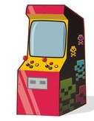
What is GoodChime?
GoodChime is a platform that......
…pulls together the ecosystem of celebrity challenges with devices, content and transactions ….
…that feeds a predictive engine to maintain consumer health engagement and make precise product and content recommendations…..
Mobile devices
Physician communication
Retail Offers
Third Party Offers
content
…on the GoodChime network and anyone that runs GoodChime’s advertising on their site.
games
Tuesday, October 16, 2012
GoodChime (C) 2011
22
Notes:
GoodChime address the whole problem, using celebrities to quickly grow our base; a social community to retain them, an agnostic approach to device integration and a revenue source based on a patent pending rules engine.
Simplify the ecosystem slide, focus on
Platform pulls together the ecosystem devices, applications, etc consumer lifestyle around health
Feeds a predictive engagement
Creates an engagement layer with products, games, apps
Sensitivity of the engine depends on big data
Celebrities and partnerships enable us to accelerate the growth of the network to reach critical mass
22

Slide 23
How GoodChime
Addresses The Need
Creating a dictionary of social health trends
Morning
Lunch
Afternoon
Dinner time
Completes
Challenge
Make Appointment
Check Rank
Celebrity gossip
New Signup
Sleep App
Dinner Recipe
Lunch Recipe
Log Health
with device
Logs Challenge
More gossip
Tuesday, October 16, 2012
GoodChime (C) 2011
23
Notes:
We create an environment for the socialization that inspires, connects, entertains and engages members to care more than do already about their health.
For the technology partner, we provide the “amusement park” through celebrities, challenges and mobile apps to measure consumer health “ in the real world.”
23

Slide 24
Huge Market
3
Estimated global market size of the wellness industry cluster in 2010 was $1.9 trillion
In USD billions
3
Statista, 2010: http://www.statista.com/statistics/168576/market-size-of-the-wellness-industry-by-segment/
Tuesday, October 16, 2012
GoodChime (C) 2011
24
Notes:
$2 trillion market
24

Slide 25
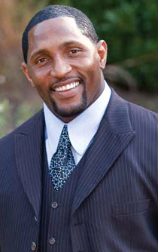

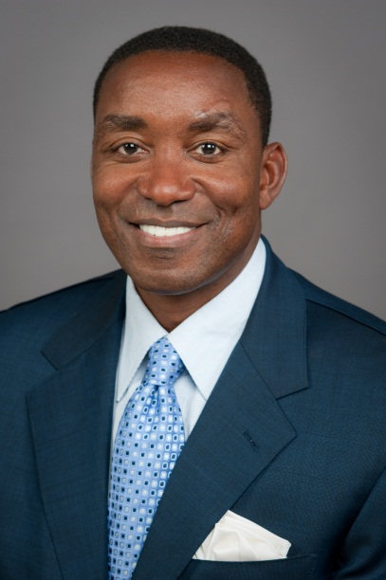

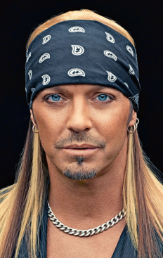
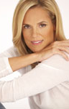



Differentiators
Celebrity Driven
Acquisition
It takes more than friends to change bad habits. Celebrities are used a customer acquisition and engagement driver.
IP Driven
Patent Pending Rules Engine Matches profile and online behavior to specific product, content and deals.
Flexible and Agnostic
can work with any device
can sync with any retailer inventory
entire platform can be redesigned to support myriad of needs
GoodChime for Employers
GoodChime for Physicians
GoodChime for Broadcasters
Dashboard
Mobile
Video & Content
Games
Transaction
Physician Data
Devices
Apps and Games
Content
Retail Inventory
Tuesday, October 16, 2012
GoodChime (C) 2011
25
Notes:
GoodChime is unique
25

